Slide 1

NatureMind
Redefining Mental Wellness
A Community-Driven Approach

Slide 2
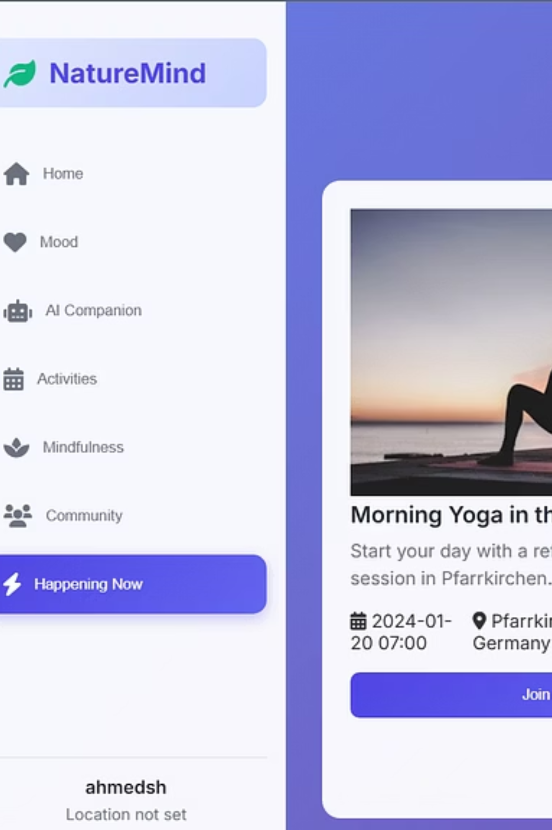
What is NatureMind?
Community-Driven Platform
Empowerment & Earnings
Connecting users through local wellness activities, mood tracking, and community support.
Users can organize and monetize wellness activities like yoga, meditation, or nature walks.
Holistic Well-being
Focused on community-based mental health improvement through real-world engagement.

Slide 3




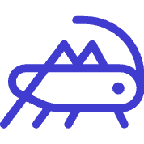
Core Features
Unlock Your Wellness Journey
Create & Earn from Activities
Join Local Events
Mood Tracker & Journal
Discover and attend wellness activities nearby.
Log daily moods, journal thoughts, and visualize progress.
Host paid wellness sessions and build your wellness brand.
Community Support Wall
Mindfulness Resources
Share experiences and connect with peers anonymously.
Access guided meditations, breathing exercises, and relaxation tools.

Slide 4
Monetization Strategy

Slide 5

Monetization Strategy
Fair & Flexible Commission
NatureMind takes a 5–8% commission from each paid activity.
1
This commission decreases based on user activity level to reward loyalty and incentivize engagement.
8% for new users
Inspired by successful models from platforms like Airbnb Experiences and Eventbrite, ensuring a sustainable ecosystem for hosts and users.
Introductory rate for hosts beginning their journey.
2
6% after 10 events
Rewarding active engagement and consistent hosting.
3
5% after 25+ hosted events
Premium rate for loyal and high-volume community leaders.

Slide 6


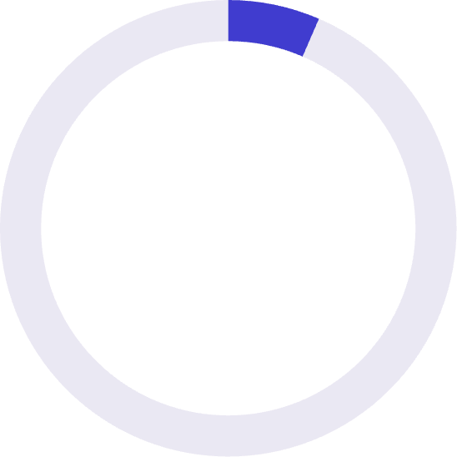
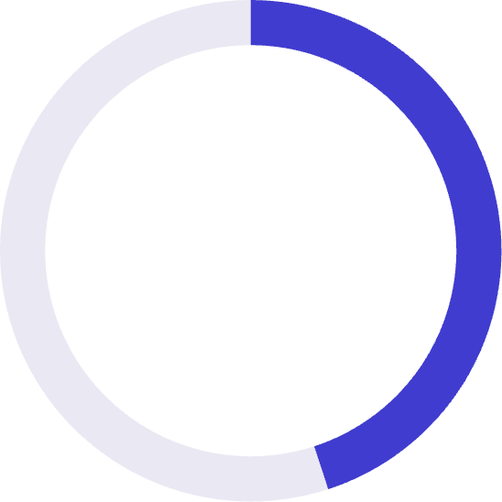
Market Opportunity
Expanding Reach
€120+B
€6.5B
€45K-€60K
Global Mental Wellness Market
Germany Wellness Market
Bavaria Revenue Goal
Includes meditation, mental health apps, retreats, and activities. Growing at >8% CAGR.
8M+ people use wellness apps or join wellness events, including yoga, mindfulness, and group activities.
Target: 150,000+ students & young professionals. Avg. activity: €10 | Projected: 8,000 events | Platform cut (avg. 6%): €48,000.

Slide 7
Competitor Analysis
NatureMind's Unique Edge
Platform Focus
Monetization
Weakness
NatureMind's Advantage
Headspace
Meditation content
Subscription-based
No real-world community
Local wellness + earnings
Calm
Sleep & meditation
Subscription-based
No earnings for users
Community-driven earnings
Meetup
General events
Organizer fees
Not wellness-specific
Wellness-centered + community
Mindbody
Wellness booking
Vendor-focused
No community or mood tracking
Holistic platform with community
NatureMind
Local wellness + earnings
5–8% commission

Slide 8

User Validation
Positive Feedback & High Acceptance
Pricing per activity: €5–€25 per session
Based on type, location, and host rating, offering flexibility.
Pilot survey in Germany: Strong interest
78% willing to pay for local wellness activities, 65% interested in earning by hosting events.
Preferred commission rate under 10%
Our fair cut of 5–8% received positive feedback from both potential users and hosts.

Slide 9
Go-to-Market Strategy
Connecting Communities
Initial Focus
Channels
Growth Plan
Germany (Munich, Berlin, Hamburg) university towns to target early adopters.
Student unions, wellness clubs, Instagram/TikTok influencer partnerships, wellness-focused Meetup groups, and retreats.
Partner with yoga studios, mental health organizations, and wellness cafes for broader reach.

Slide 10
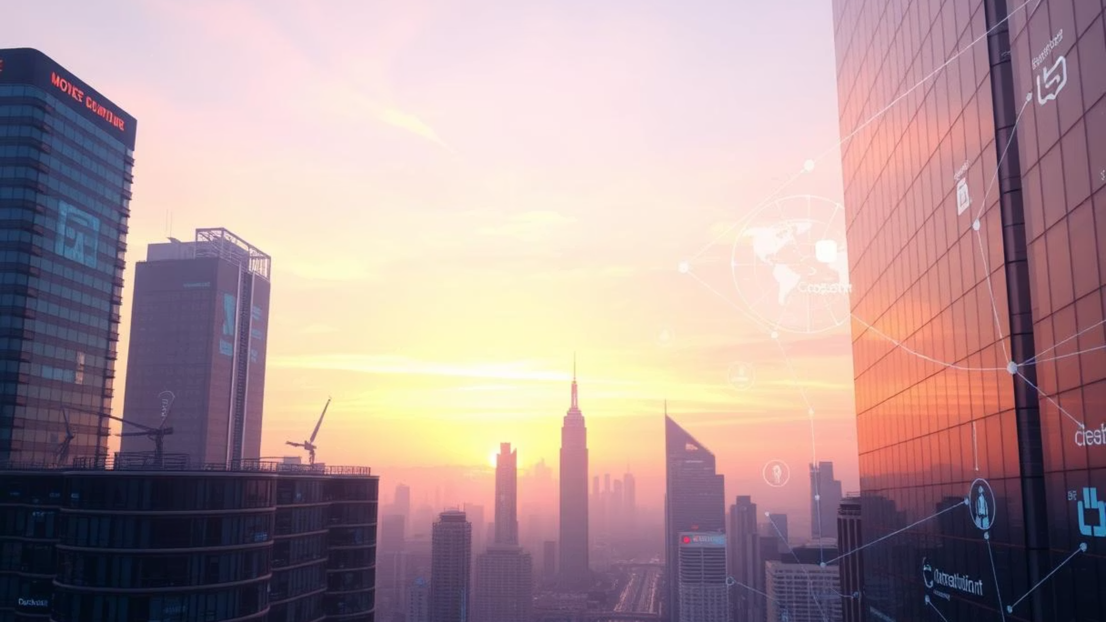
Future Vision
Beyond Today
Europe-Wide Expansion
AI-Powered Recommendations
Expand to include Europe-wide retreats and therapy sessions.
Personalized event recommendations and mood insights for enhanced user experience.
API Integrations
NatureMind Pro Launch
Seamless connection with fitness trackers like Fitbit and Apple Health for holistic well-being tracking.
A dedicated platform for certified wellness professionals.

Slide 11
Join us in redefining mental wellness.
NatureMind is poised to transform mental well-being by fostering real-world connections and empowering individuals to take charge of their health. We invite you to be a part of this journey.
NatureMind

Slide 12
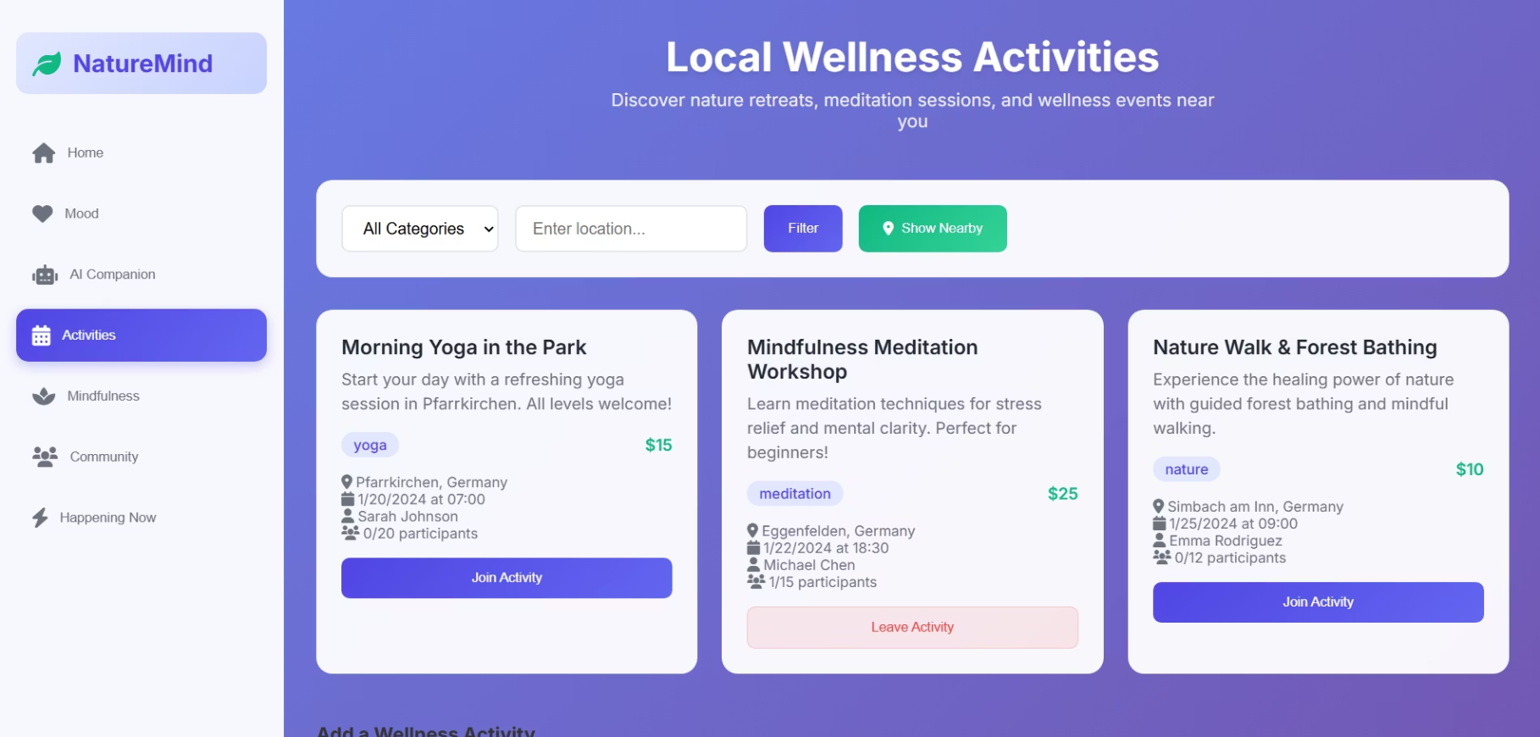
Experience NatureMind: Prototype Demonstration
Get a firsthand look at the NatureMind application and its key functionalities:
Intuitive User Interface: Navigate through event discovery and community features.
Add Community events: Users can add the events they want to host.
Join Community Events: Users can join locally happening activities.
Supportive Community Wall: Discover how users connect and share experiences.

Slide 13
Our Team
The Minds Behind NatureMind
1
Frontend Development
Abdul Hannan & Abdul Mannan
Designed and implemented the user interface using HTML, CSS, and JavaScript
Integrated mood tracking, activity listing, and community features
Ensured responsive and user-friendly design
2
Backend Development
Muhammad Ahmed Shahab
Developed the Flask backend and REST APIs
Managed database (SQLite) and user authentication
Implemented logic for activities, journaling, and posts
3
Business Research & Strategy - Backend support
Anusuya Kugavarathan
Conducted TAM/SAM/SOM analysis and competitor research
Designed the revenue model (5–8% commission on activities)
Prepared business plan and pitch slides

